Slide 3

What is Customer Relationship Management (CRM)?
Customer Relationship Management (CRM) is:
  Focuses on providing and maintaining quality service for customers, by effectively communicating and delivering products, services, information and solutions to address customer problems, wants and needs
  Total Customer Development™ Hierarchy
Customer Lifecycle Management
Customer Experience Management
Customer Quality Management tm
Customer Innovation Management tm
Customer Relationship Management
Interactive Marketing Management

Slide 4

Why CRM is a Customer and Competitive Necessity
It typically costs 5-10 times as much to acquire a new customer as it does to retain an existing one.
Most companies lose 50% of their customers in 5 years
On average only 15% of a site’s customers consider themselves loyal to it. The loyalty rating among people who had experienced a problem was only 6%. Customers who had not experienced problems indicated a customer loyalty rating of 19%. The loyalty rating among customers who had experienced problems but were satisfied with the way they were handled: 21%. (Digital Idea)
70% of repeat purchases are made out of indifference to the seller, NOT loyalty. (eLoyalty)

Slide 5

CRM Strategies
Customer Acquisition
Gain the greatest number of new “Best” customers as early in their “lifespan” as possible.
Customer Retention
Retain and expand your business and relationships with your customers through up-selling, cross-selling and servicing.
Customer Loyalty
Offer programs to ensure that your customers happily buy what you offer only from you.
Customer Evangelism
Enable loyal customers to become a volunteer sales force.
Cost Reduction
Reduce costs related to marketing, sales, customer service and support.
Improve Productivity
Enhance your e-business strategies.

Slide 6
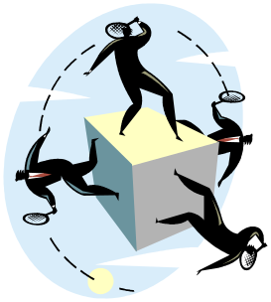
CRM People
“Customers”
  Suspects, Visitors, Prospects, Subscribers, Patrons, Members, Ticket Buyers, Users, Consumers, VIPs, Volunteers, Annual / Major Donors, Advisors, Advocates, Legislators, Strategic Partners, Sponsors …
Users
  Management, Employees, Visitors
Suppliers
  Services - Consultants
    CRM / Customer Development Experts
  Products - Technology
    Software, Hardware, Connectivity

Slide 7
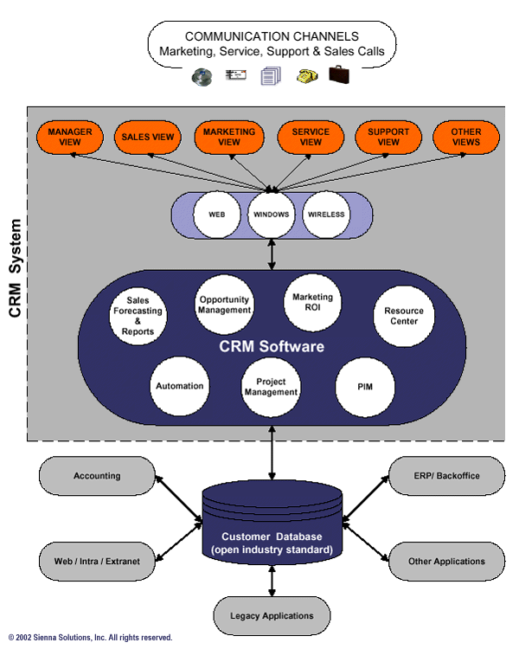
Customer Relationship Management CRM Model

Slide 8

Why Arts Organizations
Must Adopt CRM
Arts groups today are struggling to do more with less.
Rising competition for entertainment/donor dollars, especially as supporters reduce the number of causes they support.
The need for new programs and services continues to grow.
Budgets have tightened in the wake of declining endowments, reduced government, corporate and foundation funding.
Organizations are finding it tougher to sustain sales, fundraising and other forms of constituent support as traditional marketing models are not working as well.
Must add and integrate additional customer information and communication channels to respond to demand.
The “New Consumer” / “Buyer-Centric” market demands it.

Slide 9
CRM Goals, Benefits and Value
⇑ Increased Hard / Soft Results ($,%,#)
⇑ Internal: Revenue, Margins, Profitability, Results, ROI, ROA, Conversion Rates, Knowledge, Strategy, Efficiency, Effectiveness, Creativity, Products, Innovation, Morale, Customer Focus…
⇑ External: Customer Acquisition, Up-selling, Cross-selling, Personalization, Interaction, Feedback, Service, Satisfaction, Loyalty, Evangelism, Relationships, Value, Understanding…
⇓ Decreased Hard / Soft Results ($,%,#)
⇓ Internal: Costs, Time, Errors, Employee Defection, Frustration, Fear, Uncertainty, Doubt…
⇓ External: Customer Issues, Complaints, Attrition, Churn Dissatisfaction…

Slide 10

CRM Metrics
Response Rates
Well-executed event-driven marketing campaigns typically deliver response rates of the order of 25% - 50%.
Increased Sales
A well-used CRM system typically yields a direct sales revenue increase of 10%-20%.
Customer Retention
Improvement of Average Observed Customer benefit 10%-18% for Customers That Formally Measured.
ROI Justification
A 10% improvement in customer retention and increased revenues and a 14% increase in customer satisfaction, though small, can provide all the justification any company needs to implement a CRM system. (Aberdeen Group 2003)

Slide 11

WHAT CRM Tactics Can We Do Quickly, Easily, Inexpensively & Get Results?
Define Your CRM Process, Requirements and Select a System that:
Best Meets Your Current & Future Requirements.
Delivers that Greatest Value to Your Customers - Ask Them
Implement and Leverage the CRM System:
Based on your Marketing/Project Plan & Business Case.
Define, Target, Personalize, Test, Manage, Measure, Tune integrated Offline/Online Marketing Campaigns.
Develop & Segment Your Contact List / Database:
Top 20%, Most Valuable / Best Potential Customers, Network Hubs/Media, Influentials by Interests, Needs…
Partner on “Fit” Lists, Marketing Campaigns etc.
Make contacts aware of your Privacy & Data Protection Policy as an initial E-Mail message & Campaign.

Slide 12

Permission Based
Marketing
A program based on consumers granting a marketer permission to communicate with them.
Only send messages that have value to the consumer.

Slide 13


Thank You
We Welcome Your Feedback…

